Slide 1
Basic Introduction

Slide 2
Introduction
C is a general-purpose high level language that was originally developed by Dennis Ritchie for the UNIX operating system
It was first implemented on the Digital Equipment Corporation PDP-11 computer in 1972
C has now become a widely used professional language for various reasons:
Easy to learn
Structured language
It produces efficient programs.
It can handle low-level activities.
It can be compiled on a variety of computers.

Slide 3
Facts about C
Dennis Ritchie, an American computer scientist, created the C programming language in the early 1970s at Bell Laboratories
C was invented to write an operating system called UNIX.
C is a successor of B language which was introduced around 1970
The language was formalized in 1988 by the American National Standard Institute (ANSI).
By 1973 UNIX OS was almost totally written in C.
Today C is the most widely used System Programming Language.
Most of the state of the art software have been implemented using C

Slide 4
Why to use C?
C was initially used for system development work, in particular the programs that make-up the operating system
C was adopted as a system development language because it produces code that runs nearly as fast as code written in assembly language
Some examples are:
Operating Systems
Language Compilers
Assemblers
Text Editors
Utilities
Print Spoolers
Network Drivers
Modern Programs
Data Bases
Language Interpreters

Slide 5
C Compilers
When you write any program in C language then to run that program you need to compile that program
using a C Compiler which converts your program into a language understandable by a computer.
This is called machine language (i.e. binary format).
So before proceeding, make sure you have C Compiler available at your computer.
Some examples of C compilers are Turbo C and Borland C.

Slide 6
C - Program Structure
Preprocessor Commands
Functions
Variables
Statements & Expressions
Comments

Slide 7
Preprocessor Commands
This command tells the compiler to do preprocessing before doing actual
compilation.
Like:
#include <stdio.h> is a preprocessor command which tells a C compiler to include stdio.h file before going to actual compilation.
You will learn more about C Preprocessors in C Preprocessors session.

Slide 8
Functions
They are main building blocks of any C Program. Every C Program will have one or more functions and there is one mandatory function which is called main() function.
This function is prefixed with keyword int which means this function returns an integer value when it exits.
This integer value is returned using return statement.
The C Programming language provides a set of built-in functions.
printf() is a C built-in function which is used to print anything on the screen.

Slide 9
Variables,Statements & Expressions,Comments
Variables
Variables are used to hold numbers, strings and complex data for manipulation
Statements & Expressions
Expressions combine variables and constants to create new values.
Statements are expressions, assignments, function calls, or control flow statements which make up C programs.
Comments
are used to give additional useful information inside a C Program. All the comments will
be put inside /*...*/ as given in the example above. A comment can span through multiple lines.

Slide 10
Note
C is a case sensitive programming language. It means in C printf and Printf will have different meanings.
C has a free-form line structure. End of each C statement must be marked with a semicolon.
Multiple statements can be one the same line.
White Spaces (i.e. tab space and space bar ) are ignored.
Statements can continue over multiple lines.

Slide 11
Data Types in C

Slide 12
Intro
A C language programmer has to tell the system before-hand, the type of numbers or characters he is using in his program.
These are data types.
There are many data types in C language.
A C programmer has to use appropriate data type as per his requirement in the program he is going to do.

Slide 13
Primary data type
All C Compilers accept the following fundamental data types:
1 | Integer | int
2 | Character | char
3 | Floating Point | float
4 | Double precision floating point | double
5 | Void | void

Slide 14
Integer Type
Integers are whole numbers with a machine dependent range of values.
Integers are whole numbers that can have both zero, positive and negative values but no decimal values. Example: 0, -6, 200
C has 3 classes of integer storage namely short int, int and long int. All of these data types have signed and unsigned forms.
A short int requires half the space than normal integer values.
Unsigned numbers are always positive and consume all the bits for the magnitude of the number.
The long and unsigned integers are used to declare a longer range of values.

Slide 15
Floating Point Types
Floating point number represents a real number with 6 digits precision.
Floating point numbers are denoted by the keyword float.
Example: float num = 5.667;
double num = 0.003;
When the accuracy of the floating point number is insufficient, we can use the double to define the number.
The double is the same as float but with longer precision.
To extend the precision further we can use long double which consumes 80 bits of memory space.

Slide 16
Void Type
Using void data type, we can specify the type of function.
It is a good practice to avoid functions that does not return any values to the calling function.

Slide 17
Character Type
A single character can be defined as a defined as a character type of data. Characters are usually stored in 8 bits of internal storage.
Example: char value = ‘A’;
char value = ‘@’;
The qualifier signed or unsigned can be explicitly applied to char.
While unsigned characters have values between 0 and 255, signed characters have values from –128 to 127.

Slide 18
short and long
To use large number we can use long type like:
long number;
long double number;
For small integer values we can use short type:
short number;
Note : We can always check the size of variable using sizeof() operator

Slide 19
signed and unsigned
signed - allows us to store both positive and negative numbers
unsigned - allows storing only positive numbers
Example :
unsigned int num = 39;
int num = -30;
int num = 40;
unsigned int num = -30; // wrong

Slide 20
Size and Range of Data Types on 16 bit machine
TYPE | SIZE (Bits) | Range
Char or Signed Char | 8 | -128 to 127
Unsigned Char | 8 | 0 to 255
Int or Signed int | 16 | -32768 to 32767
Unsigned int | 16 | 0 to 65535
Short int or Signed short int | 8 | -128 to 127
Unsigned short int | 8 | 0 to 255
Long int or signed long int | 32 | -2147483648 to 2147483647
Unsigned long int | 32 | 0 to 4294967295
Float | 32 | 3.4 e-38 to 3.4 e+38
Double | 64 | 1.7e-308 to 1.7e+308
Long Double | 80 | 3.4 e-4932 to 3.4 e+4932

Slide 21
Declaration of Variables
Every variable used in the program should be declared to the compiler. The declaration does two things.
Tells the compiler the variables name.
Specifies what type of data the variable will hold.
The general format of any declaration
datatype v1, v2, v3, ...........,vn;
Where v1, v2, v3 are variable names.
Variables are separated by commas. A declaration statement must end with a semicolon.
Example:
int sum;
int number, salary;
double average, mean;

Slide 22
Datatype | Keyword Equivalent
Character | char
Unsigned Character | unsigned char
Signed Character | signed char
Signed Integer | signed int or int
Signed Short Integer | signed short int (or) short int (or) short
Signed Long Integer | signed long int (or) long int (or) long
UnSigned Integer | unsigned int (or) unsigned
UnSigned Short Integer | unsigned short int (or) unsigned short
UnSigned Long Integer | unsigned long int (or) unsigned long
Floating Point | float
Double Precision Floating Point | double
Extended Double Precision Floating Point | long double

Slide 23
Format specifiers in C
In C, format specifiers are used in functions like printf and scanf to specify the type of data that will be printed or read.
For Integers
%d or %i : Signed integer
%u : Unsigned integer
%o : Octal representation
%x : Hexadecimal (lowercase)
%X : Hexadecimal (uppercase)

Slide 24
Format specifiers in C
For Floating-Point Numbers
%f : Decimal notation (floating-point)
%e : Scientific notation (lowercase 'e')
For Characters and Strings
%c : Single character
%s : String
For Pointers
%p : Pointer (address)

Slide 25
Format specifiers in C
For Long and Short Modifiers
%ld : Long integer
%lld : Long long integer
%hd : Short integer
For Unsigned Long and Long Long Integers
%lu : Unsigned long integer
%llu : Unsigned long long integer

Slide 26
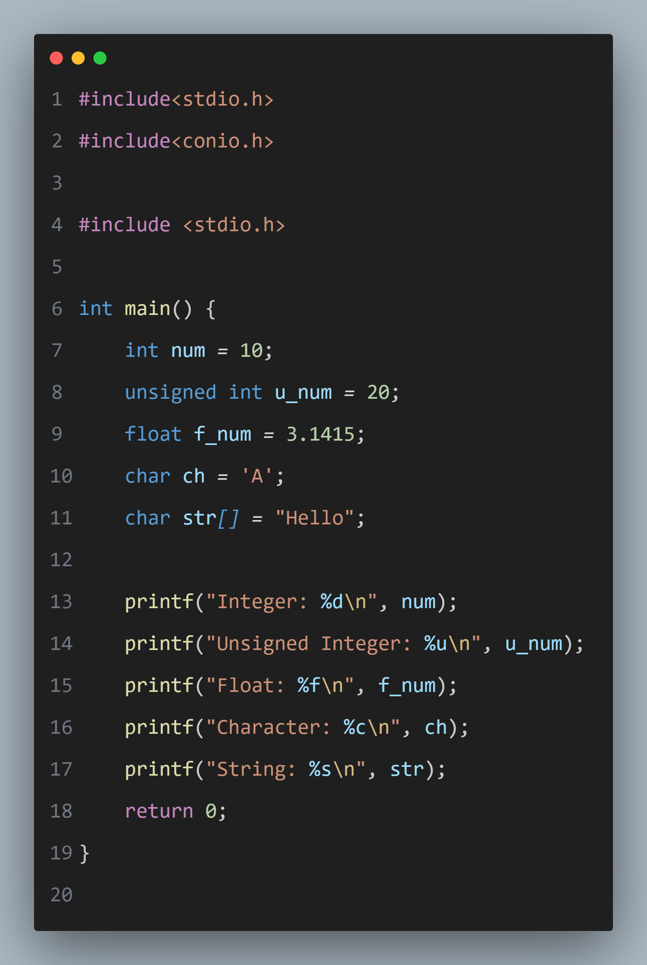
Example using Format
Specifier

Slide 27
Derived data type
Data types that are derived from fundamental data types are called derived data types.
For example: arrays, pointers,enum, structure, union, etc.
We will explore about these data types in upcoming lectures

Slide 28
printf() and scanf()
Both are inbuilt functions defined in stdio.h (header file)
printf() is used to print the statement to the console
scanf() is used to take user input from the console
#include<stdio.h>
int main(){
int number;
printf("enter a number:");
scanf("%d",&number);
printf("cube of number is:%d ",number*number*number);
return 0;
}
Example

Slide 29
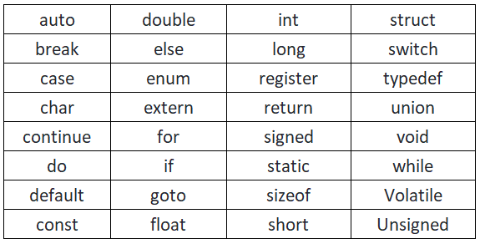
Keywords in C
A keyword is a reserved word. You cannot use it as a variable name, constant name, etc. There are only 32 reserved words (keywords) in the C language.

Slide 30
C identifiers
C identifier represents the name (name of function, variable, enum, arrays,etc.)
It can contain the combination of letters,numbers,digits, etc.
But there are certain rules on constructing identifiers:
The first character of an identifier should be either an alphabet or an underscore, and then it can be followed by any of the character, digit, or underscore.
It should not begin with any numerical digit.
In identifiers, both uppercase and lowercase letters are distinct. Therefore, we can say that identifiers are case sensitive.
Commas or blank spaces cannot be specified within an identifier.
Keywords cannot be represented as an identifier.
The length of the identifiers should not be more than 31 characters.
Identifiers should be written in such a way that it is meaningful, short, and easy to read.

Slide 31
C operators
An operator is simply a symbol that is used to perform operations. There can be many types of operations like arithmetic, logical, bitwise, etc.
There are following types of operators to perform different types of operations in C language.
Arithmetic Operators
Relational Operators
Shift Operators
Logical Operators
Bitwise Operators
Ternary or Conditional Operators
Assignment Operator
Misc Operator

Slide 32
Arithmetic Operators
These operators perform basic arithmetic operations.
+ (Addition): Adds two operands. a + b
- (Subtraction): Subtracts second operand from the first. a - b
* (Multiplication): Multiplies two operands. a * b
/ (Division): Divides first operand by the second. a / b
% (Modulus): Returns remainder of division of two operands. a % b

Slide 33
Relational Operators
These operators compare two values and return a boolean result.
== (Equal to): Checks if two values are equal. a == b
!= (Not equal to): Checks if two values are not equal. a != b
> (Greater than): Checks if the left operand is greater than the right. a > b
< (Less than): Checks if the left operand is less than the right. a < b
>= (Greater than or equal to): Checks if left is greater than or equal to right. a >= b
<= (Less than or equal to): Checks if left is less than or equal to right. a <= b

Slide 34
Shift Operators
<< (Left Shift): Shifts bits to the left, filling with zeros. a << 2 shifts bits of a two places to the left.
>> (Right Shift): Shifts bits to the right, filling with the sign bit on signed numbers. a >> 2

Slide 35
Logical Operators
These operators combine or negate boolean expressions.
&& (Logical AND): True if both operands are true. a && b
|| (Logical OR): True if at least one operand is true. a || b
! (Logical NOT): Inverts the boolean value of the operand. !a

Slide 36
Bitwise Operators
These operators perform bit-level operations on integer data.
& (Bitwise AND): Sets each bit to 1 if both bits are 1. a & b
| (Bitwise OR): Sets each bit to 1 if at least one bit is 1. a | b
^ (Bitwise XOR): Sets each bit to 1 if only one of the two bits is 1. a ^ b
~ (Bitwise NOT): Inverts all bits. ~a
<< (Left Shift): Shifts bits to the left.
>> (Right Shift): Shifts bits to the right.

Slide 37
Ternary or Conditional Operator
This is a shorthand way of writing an if-else condition.
?: (Ternary Operator): condition ? expression_if_true : expression_if_false
Example: int result = (a > b) ? a : b; assigns a to result if a > b, else assigns b.

Slide 38
Assignment Operator
These operators assign values to variables and can combine with other operations.
= (Simple Assignment): a = b assigns b to a.
+= (Add and assign): a += b is equivalent to a = a + b.
-= (Subtract and assign): a -= b is equivalent to a = a - b.
*= (Multiply and assign): a *= b is equivalent to a = a * b.
/= (Divide and assign): a /= b is equivalent to a = a / b.
%= (Modulus and assign): a %= b is equivalent to a = a % b.

Slide 39
Miscellaneous Operators
These operators are helpful in various scenarios:
Sizeof Operator: sizeof returns the size, in bytes, of a data type or variable. sizeof(int)
Comma Operator: , allows grouping multiple expressions. C=(a = 5, b = 3,a+b) evaluates both expressions and returns the last value.
Pointer Operators: & (address of) and * (dereference). int *p = &a; makes p point to a.
Type Casting: (type) expression changes the data type of a value. (float) a / b

Slide 40
Comments in C
Single line comment
Single line comments are represented by double slash //. Let's see an example of a single line comment in C.
// adding two numbers
int sum = a + b;
Multi line comment
Multi-Line comments are represented by slash asterisk \* ... *\. It can occupy many lines of code
/*
code
to be commented
*/

Slide 41
Escape sequence in C
Escape Sequence | Description
\n | Newline (moves cursor to the beginning of the next line)
\t | Horizontal tab
\\ | Backslash
\" | Double quote
\' | Single quote
\a | Alert (produces a beep sound in some systems)
\b | Backspace
\r | Carriage return
\v | Vertical tab
\0 | Null character
used to put nonprintable characters in character and string literals
A backslash (\) followed by one or more special character is known as escape sequence

Slide 42
Constants
If you want to define a variable whose value cannot be changed, you can use the const keyword
We can define constant in 2 ways:
const keyword
const double PI = 3.14;
#define preprocessor
#define PI 3.14

